Slide 1
Meningitis beyond the neonatal age
August 7^{th ,} 2021
Gemechu Edae: MD, Assistant professor of pediatrics
Dept of Peds, CHS, AU.

Slide 2
Central Nervous System Infections
Significant cause of morbidity and mortality in children.
Classified according to the affected tissue:-
- Meningitis:-
- Encephalitis indicates brain parenchymal involvement.
These anatomic boundaries may be indistinct during infection.
Notes:
Anatomic boundaries may be indistinct during infection, and patients may have evidence of both meningeal and parenchymal involvement.

Slide 3
Bacterial meningitis

Slide 4
  DEFINITION
  -Acute & diffuse bacterial infection of the CNS with primary involvement of the meninges .

Slide 5
ETIOLOGY
In general: viruses > bacteria > fungi > parasites, in terms of …
    ● Pathogen is influenced by :
      Age of the host
      Immune status of the host
      Epidemiology of the pathogen
  a) Birth - 2 months
      Group B Streptococci (Streptococcus agalactiae)
      Gram –negative enteric bacilli(E.coli, klebsiella)
      Listeria Monocytogenes
      Group D streptococci (Enterococcus)
  b) 2 month - 12 years
      S. Pneumoniae
      N. Meningitidis
      H.. influenza type B ( 70% of cases of meningitis in <5 yr of age )
  c) Other less common pathogens
  P. aeruginosa, S. aureus, CONS, Salmonella spps, L. monocytogenes

Slide 6
Etiology..
H. influenzae
  Invasive infections occur primarily in the 1st 2 month -2 yrs of life
  Peak incidence 6 - 9 month of age
  Risk factors :
    Family or day care center contacts of patients with H . inf type b disease
    Unvaccinated individuals
    Individuals with blunted immunologic response to vaccine
    e.g. child with HIV infection
S. Pneumoniae
  Invasive infection peaks during the first 2 yrs of life
  Risk factors :
    Age < 2 yrs
    Asplenia (functional or anatomic )
    HIV infection
    Otitis media, sinusitis, pneumonia
    CSF otorrhea or rhinorrhea
    Presence of cochlear implant: risk of meningitis increased by more than 30-fold

Slide 7
Etiology...
N. meningitidis
  Serogroups:- A ,B ,C, X, W135,Y
      - Epidemic disease serogroup A
  Cases are common in winter & spring: ...
  Nasopharyngeal carriage:- 1-15 % of adults
  Attack rate in family…..1 %
  Bimodal peak:- younger than 5 yr and b/n 15-24 yr of age
  Most infections of children are acquired from :
      Contact in a day care facility
      Colonized adult family member
      Ill patient with meningococcal disease
Notes:
The incidence of disease occurring in association with an index case in the family is 1%, a rate that is 1,000-fold the risk in the general population. The risk of secondary cases
occurring in contacts at daycare centers is approximately 1 in 1,000. Meningococcal cases are more common in the
winter and spring, likely due to associations with viral infections including influenza.

Slide 8
General risk factors
Lack of immunity associated with young age.
Male gender
Black race
Infants & young children with occult bacteremia:-the odds ratio is greater for meningococcus (85 times) and H. influenzae type b (12 times) relative to that for pneumococcus.

Slide 9
Specific risk factors…
Complement system (C5-C8), properdin defects (N meningitidis)
T-lymphocyte defects (L. monocytogenes)
Congenital or acquired CSF leak (pneumococcus)
Lumbosacral dermal sinus and meningomyelocele
(staphylococcal & gram-negative enteric bacteria)
CSF shunt infections (staphylococci spp,……

Slide 10
Epidemiology
Mode of transmission:- Person to person contact through respiratory tract secretions or droplets
Meningococcal meningitis is the only form of bacterial meningitis that causes outbreaks.
The largest outbreaks occur mainly in the semi-arid areas of sub-Saharan Africa, designated the African “meningitis belt”.
Epidemics previously occurred every 8-12 yrs, however in recent years they have been occurring yearly.
Serogroup A accounts for 80–85% of out-breaks.

Slide 11
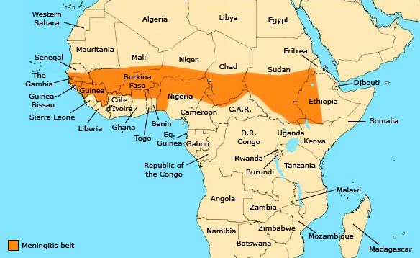

Slide 12
Pathogenesis: Out side the neonatal period is typically due to bacterial colonization of the nasopharynx with subsequent invasion into the bloodstream,
Bacterial colonization of nasopharynx
Attach to mucosal epith.
cell receptors by pili
Breach mucosa & enter circulation
Large capsules interfere
with phagocytosis
To CSF through choroid
plexus of ventricles
Extra-cerebral CSF &
Sub-arachnoid space
Bacterial proliferation
Inflammation-cytokines
Notes:
In nonimmune hosts, the defect may be from an absence of preformed IgM or IgG anticapsular antibodies, whereas in immunodeficient patients, various deficiencies of components of the complement or properdin system may interfere with effective opsonic phagocytosis.
Bacteria gain entry to the CSF through the choroid plexus of the lateral ventricles and the meninges and then circulate to the extracerebral CSF and subarachnoid space. Bacteria rapidly multiply because the CSF concentrations of complement and antibodies are inadequate to contain bacterial proliferation.

Slide 13
Pathogenesis…
Rarely, meningitis may follow bacterial invasion from a contiguous focus of infection such as:-
Paranasal sinusitis,
Otitis media,
Mastoiditis,
Orbital cellulitis, or cranial or vertebral osteomyelitis
Via penetrating cranial trauma, dermal sinus tracts, or meningomyeloceles
Notes:
Tentorial, falx, or
cerebellar herniation does not usually occur, because the increased ICP
is transmitted to the entire subarachnoid space and there is little structural
displacement. Furthermore, if the fontanels are still patent, increased
ICP is not always dissipated

Slide 14
Pathology and pathophysiology
  Meningeal exudates ( with variable thickness )
  Ventriculitis:
  Subdural effusions
    Occurs in later phase:- because of transudation of fluid
  Subdural empyema
  Perivascular inflammatory infiltrates
Notes:
purulent exudate of varying thickness may be distributed around the cerebral
veins, venous sinuses, convexity of the brain, and cerebellum, and in the sulci, sylvian fissures, basal cisterns, and spinal cord. Ventriculitis with bacteria and
inflammatory cells in ventricular fluid may be present (more often in neonates), in addition to subdural effusions and empyema.

Slide 15
  Pathology and pathophysiology …
  Cerebral infarction: may range from microscopic to an entire hemisphere.
  Inflammation of the spinal nerves and roots
    Produces meningeal signs
  Inflammation of the cranial nerves
    Produces cranial neuropathies(2,3,7,8)
  Increased ICP
    Uncal herniation…..temporal lobe compression of oculomotor nerve…3 nerve palsy
    Types of cerebral edema :
    Cell death ( cytotoxic cerebral edema )
    Cytokine-induced increased capillary permeability ( vasogenic cerebral edema )
    Increased hydrostatic pressure ( Interstitial cerebral edema )
  SIADH
    Excessive water retention → Increased risk of elevated ICP
    Hypotonicity of brain extra cellular spaces → cell swelling and lysis → Cytotoxic edema
Notes:
Cerebral infarction is a frequent sequela that is caused by vascular occlusion from inflammation, vasospasm, and thrombosis.

Slide 16
CLINICAL MANIFESTATIONS
    The severity and constellation of signs are determined by host–pathogen interactions and the affected region of the CNS
    Two patterns of onset :
    a ) Dramatic onset (less common )
    Shock, purpura, DIC, reduced LOC, death with in 24 hour.
    b) Gradual onset (more common )
    Meningitis is preceded by several days of fever accompanied by URT or GI symptoms:
    -followed by nonspecific signs of CNS infection like increased lethargy & irritability .

Slide 17
CLINICAL MANIFESTATIONS…
Non-specific findings:
Fever, anorexia, poor feeding, symptoms of URTI, myalgias, arthralgias, ↑HR, ↓BP, petechiae, purpura, erythematous macular rash
Signs of meningeal irritation :- Back pain, neck stiffness, Kernig sign, Brudzinski sign.
Papilledema, photophobia
Focal neurologic signs:- 10 - 20% of cases
Cranial neuropathies:..

Slide 18
CLINICAL MANIFESTATIONS…
    Signs of increased ICP
      - Headache, emesis, bulging fontanel, diastasis
      (widening ) of the sutures
      - Oculomotor or abducens nerve palsy
      - HTN with bradycardia; stupor, coma
      - Apnea or hyper ventilation, signs of herniation
      - Decorticate or decerebrate posturing
    Seizures
      - Focal or generalized
      - 20 -30 % of cases
      - Causes : cerebritis, infarction, or electrolyte disturbance
    Alteration of mental status
      - Common
      - Causes : increased ICP, cerebritis, hypotension
      - Manifestations : irritability, lethargy, stupor, coma.

Slide 19
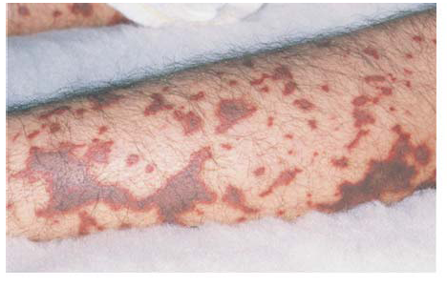
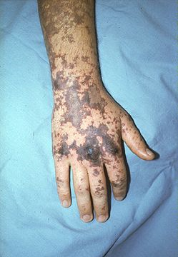
Skin lesions in acute meningococcemia can begin as papules but quickly progress to petechiae & purpura. As seen here, the purpuric lesions can coalesce

Slide 20
Diagnosis
CSF analysis and culture
Blood cultures (positive in 80% to 90% of cases)
* When you need to evaluate complications
Neuro-imaging (Brain U/S, CT, MRI)
Urinalysis and serum sodium

Slide 21
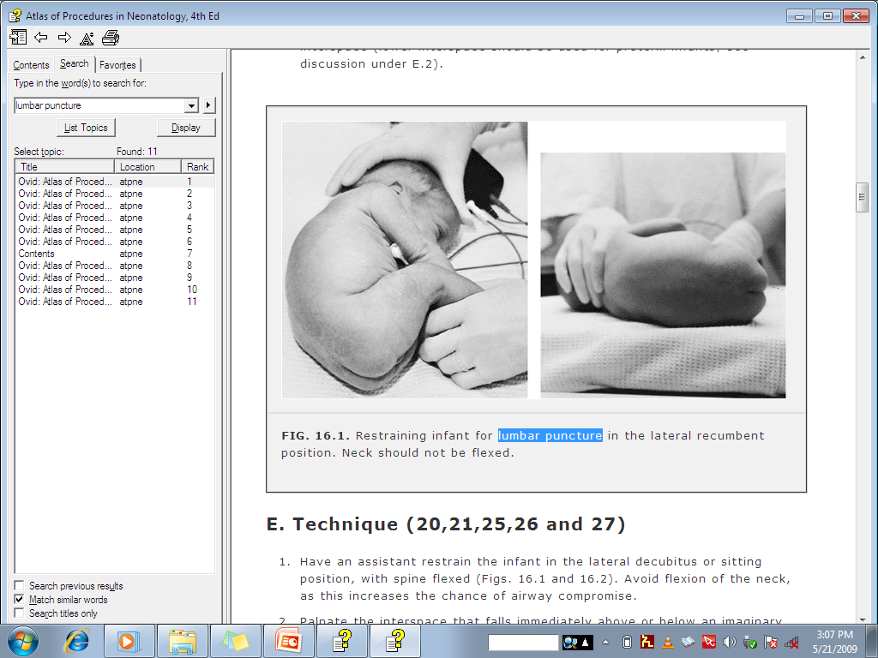
Lumbar puncture

Slide 22
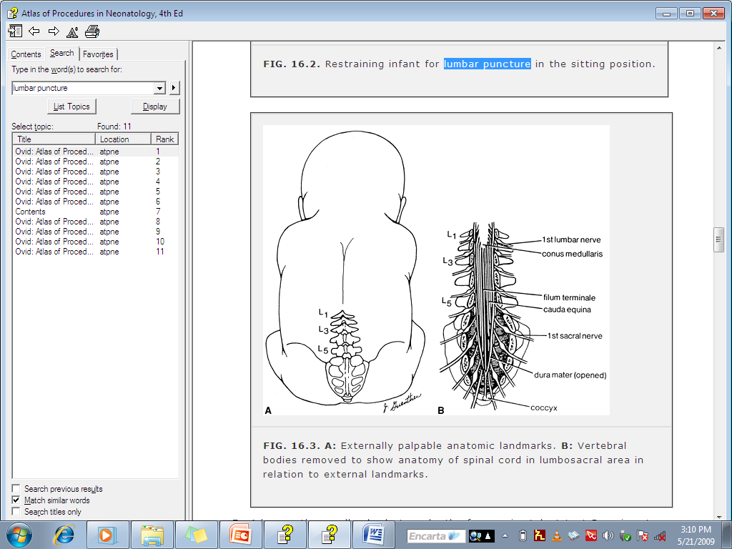
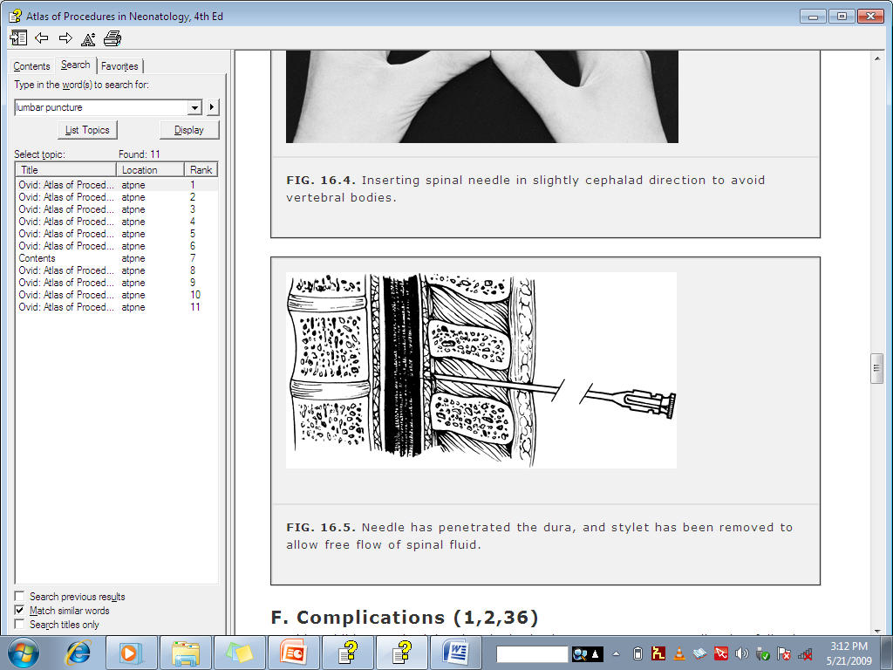
Lumbar puncture

Slide 23
Lumbar puncture
INDICATIONS:-...
To diagnose central nervous system (CNS) infections
To monitor efficacy of antimicrobial therapy in CNS infection
To drain CSF in communicating hydrocephalus associated with IVH
To diagnose intracranial hemorrhage
To diagnose CNS involvement with leukemia
To inject chemotherapeutic agents
To instill contrast material for myelography 7

Slide 24
Lumbar puncture
CONTRAINDICATIONS:
Increased intracranial pressure (ICP)
Uncorrected thrombocytopenia or bleeding diathesis
Infection in the skin or underlying tissue at or near the puncture site
Lumbosacral anomalies
Cardiorespiratory instability, which may be exacerbated by the procedure

Slide 25
CSF analysis
In bacterial meningitis:- CSF shows ↑ pressure, ↑ protein (BBB
inflammation), ↓ glucose (altered glucose transport by the cerebral tissue…), and many neutrophils.
* turbid/frank pus – a minimum of 200 cells/mm3
Presence of infecting organism/antigenic capsular substance confirms dx
Gram stain is positive in > 70% of patients with untreated bacterial meningitis..
Traumatic LP may also complicate the interpretation of CSF tests:

Slide 26
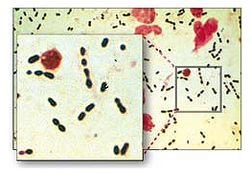
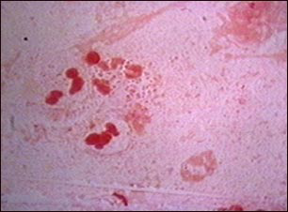
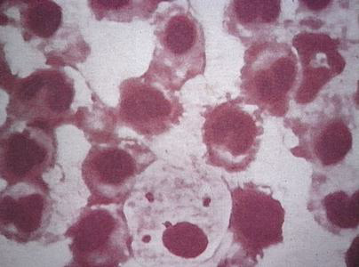
S Pneumoniae
H influenzae
N meningitidis

Slide 27
CSF analysis…
Cultures often are negative if the patient has been treated with antibiotics prior to culture.
Detection of capsular polysaccharide antigens by rapid latex agglutination tests in CSF can support diagnosis in such cases.

Slide 28
DIFFERENTIAL DIAGNOSIS
  INFECTIONS
    Generalized infection of the CNS
      Bacteria
        M. Tuberculosis (Tb meningitis)
        T. Pallidum (Syphilis )
      Fungi
        Histoplasma ,Candida ,Cryptococcus Aspergillus
      Parasites
        T. gondii , Cysticercosis, Malaria
      Viruses
        Enteroviruses, HSV (Viral meningoencephalitis)

Slide 29
DDX…
    2. Focal infections of the CNS
      Brain abscess
      Para meningeal abscess
        Subdural empyema
        Cranial epidural empyema
        Spinal epidural empyema
  B. NON-INFECTIOUS ILLNESSES
    Cause generalized inflammation of the CNS
    Uncommon
        Malignancy
        Collagen vascular syndromes
        Exposure to toxins
  All acute febrile illnesses can be D.DX of acute bacterial meningitis especially in its early phase.

Slide 30
Form of meningitis | Opening pressure | WBCs & differential | Protein | Glucose | Comments
Normal values | < 28 cm H₂O | < 5, >75% lymphocytes | 20 - 45 mg/dl | > 50 mg/dl or 75% of ..
Acute bacterial meningitis | Usually ↑ (100 to 300) | Usually 300 –2,000; PMNs predominate | Usually 100 – 500 | Usually < 40 | Organisms usually seen on Gram stain / culture
Partially treat-ed bacterial meningitis | Normal or elevated | 5 – 10,000; PMNs usual | Usually 100 – 500 | Normal or decreased
Viral meningitis | Normal or slightly ↑ (80 – 150) | Rarely >1,000 cells. Mono-nuclear cells predominate | Usually 50 – 200 | Generally normal
TB meningitis | Usually elevated | 10 – 500; lymphocytes predominate | 100 – 3,000 | < 50 in most cases | Acid-fast org-anisms rarely seen on smear

Slide 31
Principles of treatment
It is a medical emergency
Always use high dose, parenteral (IV) antibiotics as soon as the LP is done
IV antibiotics as soon as possible if there are contraindications for LP; then do a CT scan
Treat raised ICP and seizures (if present)
Supportive care: feeding, …. Follow with..
IV dexamethasone QID for 2 days (> than 6 wks of age:- give 1-2 hr before antibiotics are initiated or concurrently with the 1st dose of antibiotics.

Slide 32
Treatment...
Empirical antibiotic regimen in a suspected case of meningitis outside the neonatal period is:
Vancomycin combined with a third generation cephalosporin (ceftriaxone).
Can be treated with penicillin G or ampicillin
Chloramphenicol can also be added to penicillin.
- Even though it’s a bacteriostatic antibiotic, it is bactericidal for S. Pneumoniae, H. influenzae, and N. meningitidis

Slide 33
Treatment…
Duration of treatment
Generally total of 10 days
Specific ( based on etiologic agent ) in uncomplicated cases
N meningitidis 5-7 days
H influenzae 7-10 days
S pneumoniae 10-14 days
L monocytogenes 14-21 days
Enteric GN rods 3 wks

Slide 34
Acute complications
Seizures
Raised ICP
DIC, shock
Cranial nerve palsies
Stroke
Cerebral or cerebellar herniations
Thrombosis of the dural venous sinuses
Subdural effusion
Ventriculitis with hydrocephalus
SIADH

Slide 35
Chronic complications
Visual impairment
Sensorineural hearing loss
Behavioral problems
Cognitive dysfunction
Recurrent seizures
Delay in acquisition of language

Slide 36
PROGNOSIS
  POOR PROGNOSTIC FACTORS
    Pneumococcal meningitis
    Age < 6 months
    >10⁶ colony – forming units of bacteria / ml of CSF
    Seizure occurring after 4 days of therapy
    Coma or focal neurological signs on presentation
  Mortality: < 10 % with antibiotic therapy and supportive care
  Severe neurodevelopmental sequalae:- 10 -20 % of cases
  Neurobehavioral morbidity:- 50 % of cases
  Most common neurologic sequalae
    Hearing loss
    Mental retardation , delay in acquisition of language
    Seizures
    Visual impairment , behavioral problems

Slide 37
Prevention
Conjugate pneumococcal vaccines (Eg PCV10)
Conjugate Hemophilus influenzae type b vaccine
Conjugate meningococcal vaccine (MCV4)
Contains capsular polysaccharides from serogroups A, C, W-135, and Y conjugated to diphtheria toxoid.

Slide 38
Prophylaxis against meningococcal meningitis
Recommended for all close contacts of patients with meningococcal meningitis, regardless of age or immunization status.
Prophylaxis not routinely recommended for medical personnel except those with intimate exposure (mouth-to-mouth resuscitation, intubation, suctioning before antibiotic therapy was begun.
Children may be given Rifampin or Ceftriaxone
Ciprofloxacin (500 mg PO stat) may be given to persons ≥18 yr.
Penicillin doesn’t eradicate nasopharyngeal carriage; patients treated with penicillin should get prophylaxis before discharge.

Slide 39
Prophylaxis against H. influenzae type b meningitis
Rifampin prophylaxis should be given
to all household contacts of patients with invasive disease caused by H. influenzae type b,
if any close family member younger than 48 mo has not been fully immunized or
if an immunocompromised person, of any age, resides in the household.

Slide 40
Tuberculous Meningitis

Slide 41
Etiology & Epidemiology
Etiology
Mycobacterium Tuberculosis
Non-spore forming, non-motile, pleomorphic ,weakly gram-positive, acid-fast bacilli
Epidemiology
Occurs in 0.3% of untreated TB infections
Peak age: 6 mo - 4 yr of age
BCG vaccination prevents it

Slide 42
Pathology and Pathophysiology
Lymphohematogenous dissemination of the primary (lung in > 90% of cases) infection leads to formation of metastatic caseous lesion in the cerebra cortex or meninges
Exudates formation
Salt wasting or SIADH result in abnormal electrolyte metabolism
Vasculitis, infarction, cerebral edema, and hydrocephalus
Brain stem: site of greatest involvement

Slide 43
Clinical Manifestations
Clinical course :
Rapid progression
Infants & young children, occurs in several days before the
onset of acute hydrocephalus, seizures, and cerebral edema.
B. Slow progression
Occurs in several weeks
Has 3 stages

Slide 44
1st Stage
Lasts 1-2weeks
Non specific symptoms:-
Infants can experience a stagnation or loss of developmental milestones.
2nd Stage
Abrupt in onset
Lethargy, +ve meningeal signs, seizures, hypertonia, vomiting, cranial nerve palsy, other focal neurologic signs, signs of encephalitis with no meningeal signs
3rd Stage
Coma, hemiplegia or paraplegia, hypertension
Decerebrate posturing, deterioration of vital signs, and finally death.

Slide 45
Diagnosis
PPD: -ve in 50% of cases
CXR: Normal in 20-50% of cases
CSF (Specimen volume:5-10 ml )
WBC :10-500/mm3(Lym.predominant)
Glucose : <40mg/dl (rarely <20mg/dl)
Protein: 400-5000mg/dl
Smear for AFB:+ve up to 30% of cases
Culture:+ve in 50-70% of cases
PCR : may be positive

Slide 46
CT or MRI of the brain
Normal in early stages of TB meningitis
Basilar enhancement, communicating hydrocephalus, signs of cerebral edema, early focal ischemia
One or more clinically silent tuberculomas may be seen in the cerebral cortex or thalamic areas
N.B: Dx of TB meningitis can be difficult early in its course and requires HIS

Slide 47
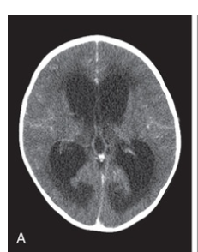
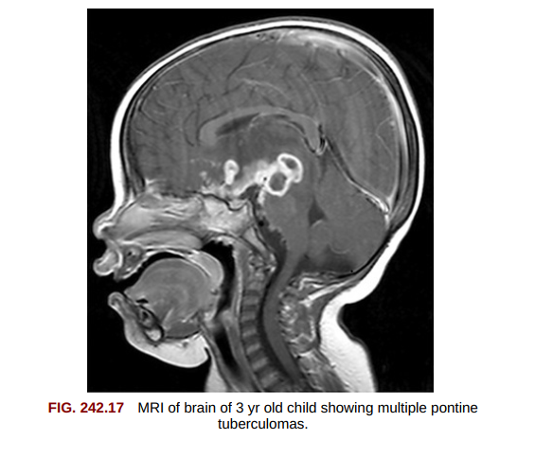

Slide 48
Treatment
Anti TB
Directly Observed Therapy (DOTs Regimen)
2RHZ E or S / 7-10 RH: - (Total: 9-12 mo. )
Steroids
Prednisone, 1-2 mg/kg/day in 1-2 divided doses orally for 4-6 weeks , followed by gradual tapering
Rx of complications:
Increased ICP , Seizures, Hydrocephalus (CSF shunts)

Slide 49
Complications
Blindness, deafness, paraplegia or hemiplegia, mental retardation, DI, hydrocephalus, cranial nerve palsy, seizures
Prognosis
Correlates with clinical stage at time of initiation of Rx:
- 1st stage has excellent outcome
- 3rd stage survivors have permanent disabilities
Better for older child than for young infant
Prevention
Prevention of primary Tb infection :
- Vaccination (BCG)
Early Dx & Rx of TB cases

Slide 50
Viral Meningoencephalitis

Slide 51
Definition
It is an acute inflammatory process involving the meninges and/or brain tissue to a variable degree.
Etiology
Enteroviruses (coxsackievirus, echovirus, enterovirus, poliovirus)
- Most common cause, small RNA viruses
- More than 80 serotypes
Herpes viruses
- HSV-1, HSV-2, VZV, CMV, EBV, HHV-6
Mumps, HIV

Slide 52
Etiology ...
Arboviruses: broad range of viruses from multiple viral families
- Mosquitoes and ticks are most common vectors
- Tend to affect the entire brain
- Birds or small animals ……Humans
e.g. West Nile virus
Other viruses/occasional causes/
- Rubella, rubeola, rabies
- Respiratory viruses : Adenovirus, Influenza virus, parainfluenza virus
Live virus vaccinations/rare causes/
- Polio, measles, mumps, rubella

Slide 53
Epidemiology
Enteroviruses :
- Direct spread from person to person, IP is 4-6 days
Other factors : Season, geography, climate conditions, animal exposures, etc.
Pathogenesis and pathology
- Neuronal disruption, tissue necrosis, meningeal congestion
- Neuronal damage from :
1) Direct invasion and destruction of neural tissues by virus
2) Host reaction to viral agents

Slide 54
Clinical Manifestations
Determinant factors are :
1) Relative degree of meningeal & parenchymal involvement
2) Specific etiology
Mild self-limited illness to severe encephalitis with sequelae or resulting in death
Fever, headache, nausea, vomiting, photophobia, pain of (neck, back and legs).
Nuchal rigidity, irritability, change in mental status, convulsions, bizarre movements, hallucinations
Exanthems precede or accompany CNS signs

Slide 55
Diagnosis
Mainly clinical :
- Nonspecific prodrome followed by progressive CNS symptoms
CSF
- WBC : 10-100,mm3(up to 1000/mm3)
Mononuclear cells predominate later
- Protein : 50-200 mg/dl
- Glucose : normal (mumps <40mg/dl)
- PCR : for HSV & enteroviruses
- Culture : for enteroviruses(70% detection)

Slide 56
Diagnosis...
Serologic tests:
- For arboviruses
- Not practical for enteroviruses
EEG: diffuse slow-wave activity usually without focal changes
CT/MRI: swelling of the brain parenchyma
N.B: Focal seizures or focal findings on EEG, CT, or MRI, especially involving the temporal lobes suggest HSV encephalitis.

Slide 57
Treatment
Supportive
- Rest
- Non-aspirin containing analgesics: Acetaminophen is best
- Reduction in room light ,noise
- IV fluids : if poor oral intake
- In severe cases : ICU care
Acyclovir for HSV encephalitis
Rx of complications :
- Increased ICP, SIADH ,seizures, etc.

Slide 58
Complications
Increased ICP(cerebral edema)
Coma
Convulsions
Fluid & electrolyte imbalance
Aspiration , Asphyxia
SIADH
Cardiac or respiratory arrest of central origin

Slide 59
Prognosis
Most children recover completely
Depends on :
Severity of clinical illness
Specific etiologic agent
Age of the child (Poor for infants)
Potential deficits in severe cases :
- Intellectual, motor, epileptic, psychiatric,
- Auditory, visual

Slide 60
Prevention
Vaccination
- Polio
- Measles
- Mumps
- Rubella
- Rabies
Control of insect vectors & minimizing mosquito bites

Slide 61
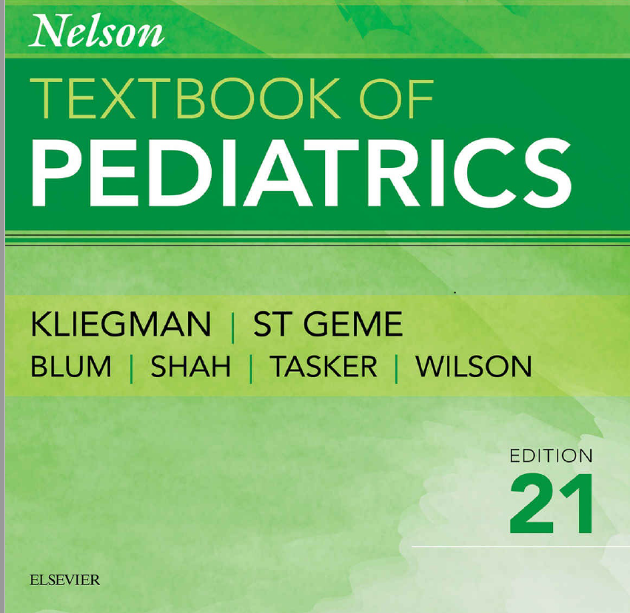
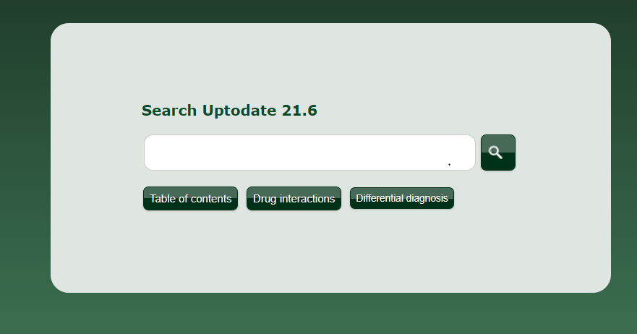
REFERENCES

Slide 62
THANK YOU

